Slide 1


Provide better
environment
Looking for
best school

Slide 2
Rich education sources
Number of school 2244（2018）
FTE enrollments 971669.2
Immigration state
Immigrants out of population change: 83%
Unsteady Enrollment number
Source: odysseyseaglass.com/sea-glass-in-australia.html

Slide 3
Parents：Rights
Which schools they can choose？
School：enrolment pressures
How many students are interested？

Slide 4
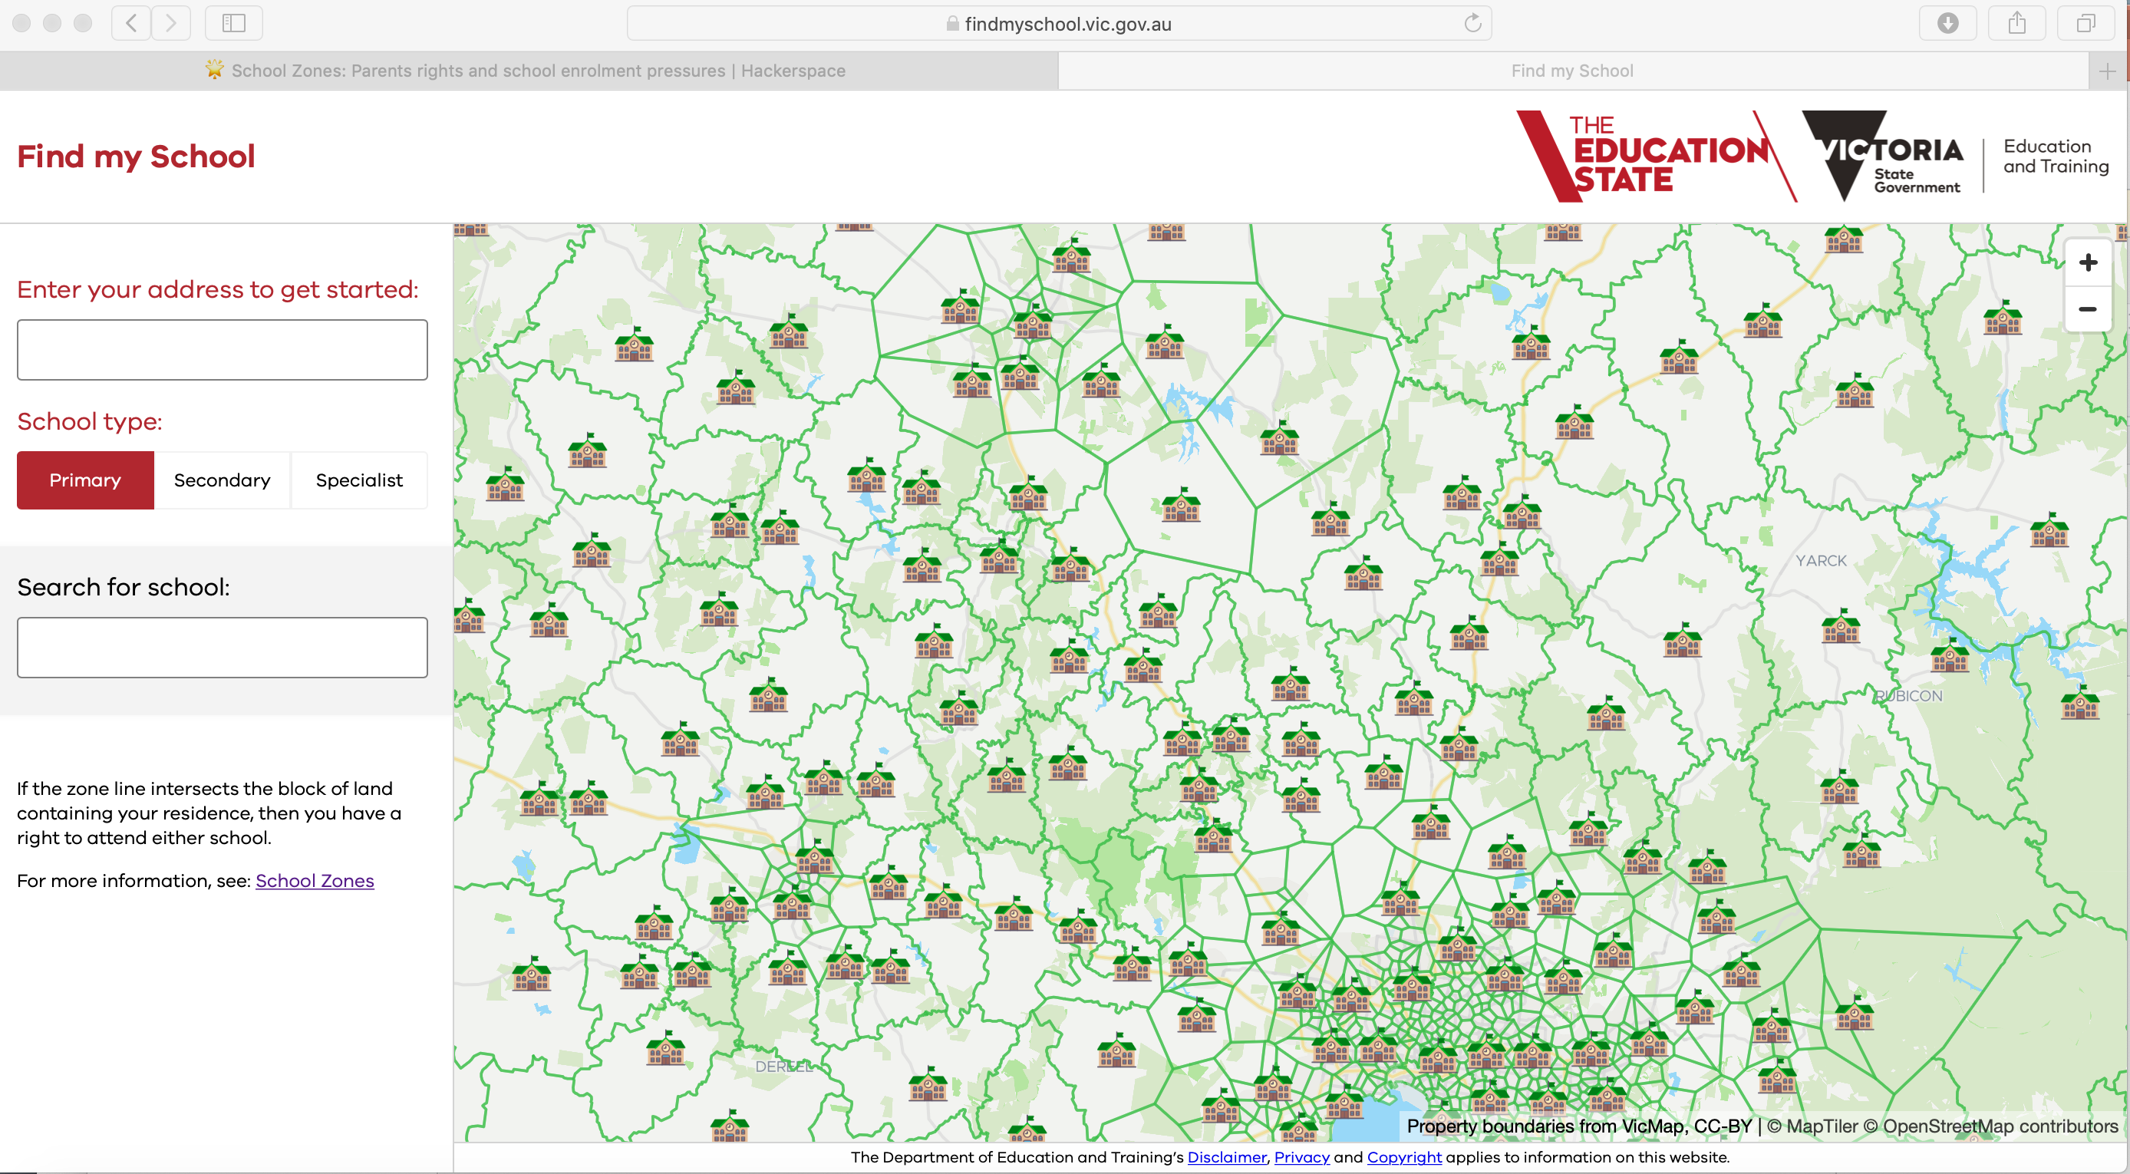
Demand？
Capacity？
Other information?

Slide 5
Parents：Rights
Which schools they can choose？
Convenient ：near their home
Suitable：Public/Catholic/Specialist
Quality：Reputation，Ranking
School：enrolment pressures
How many students are interested？
Control the number of class
Predict the future demand

Slide 6
Parents：Rights
Bob
Ruby

Slide 7
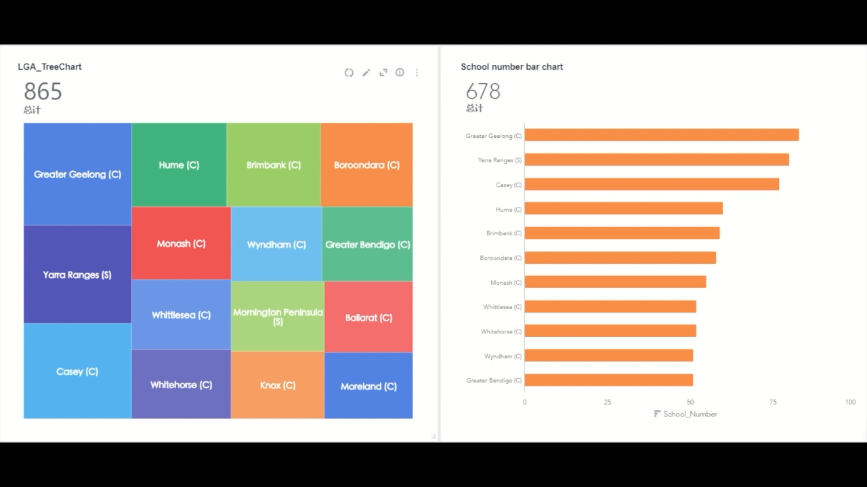

Slide 8
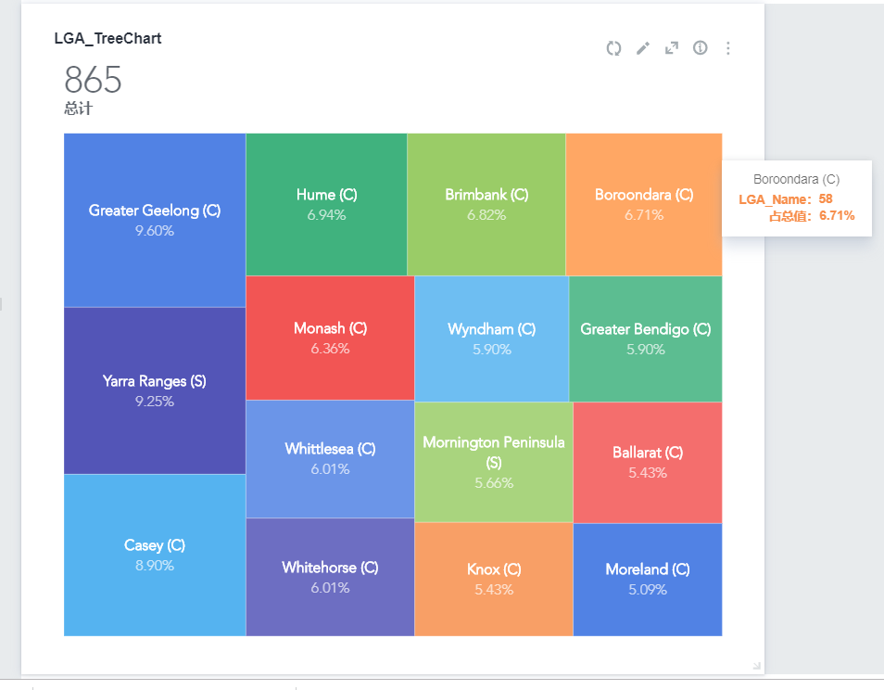
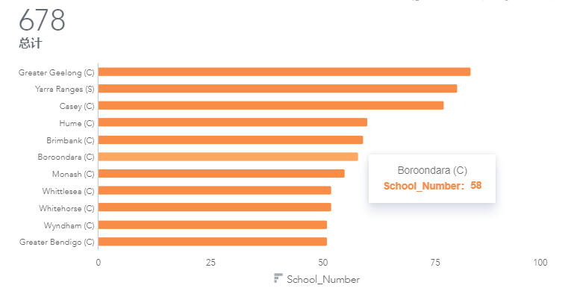
Proportion
Top15

Slide 9
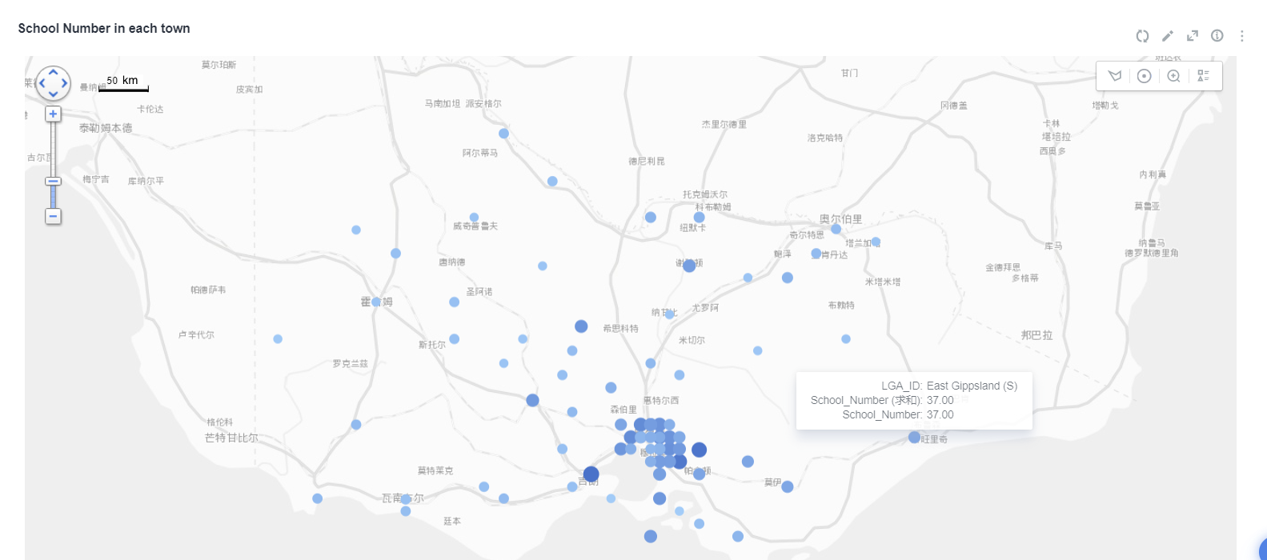

School Number of Each Town

Slide 10
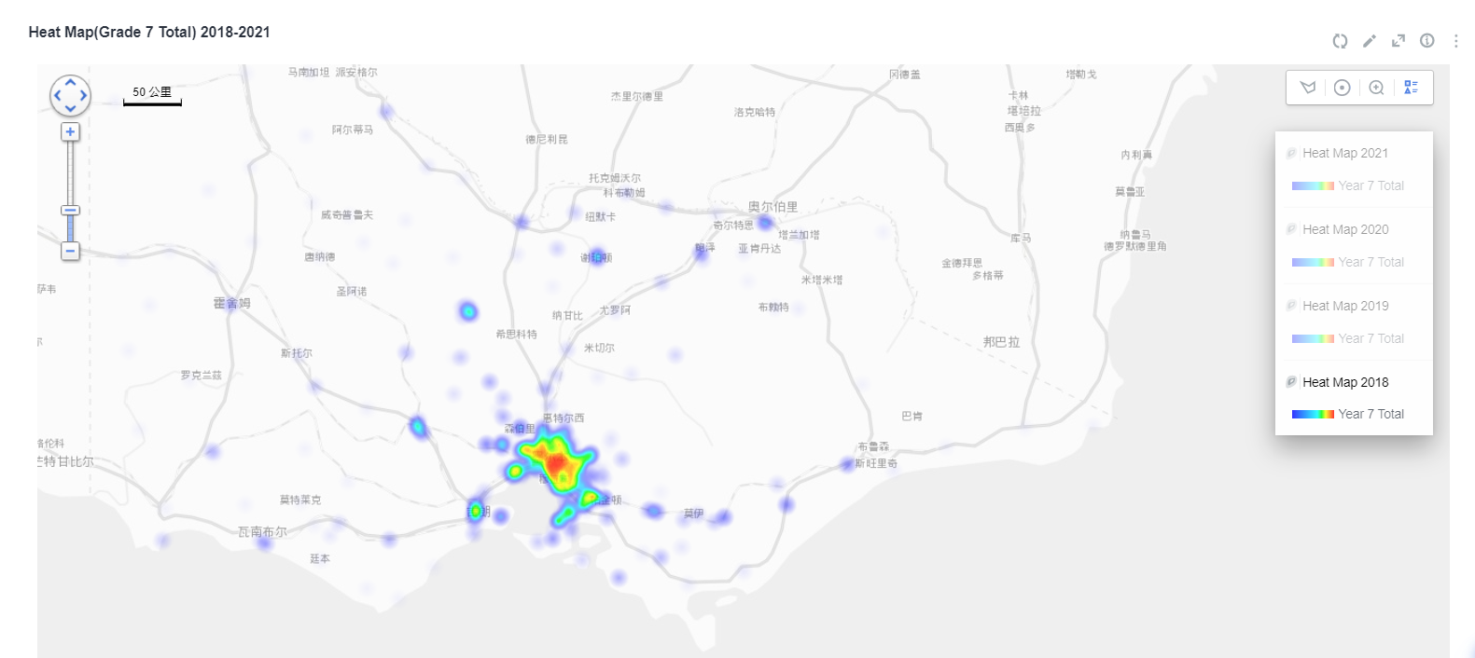
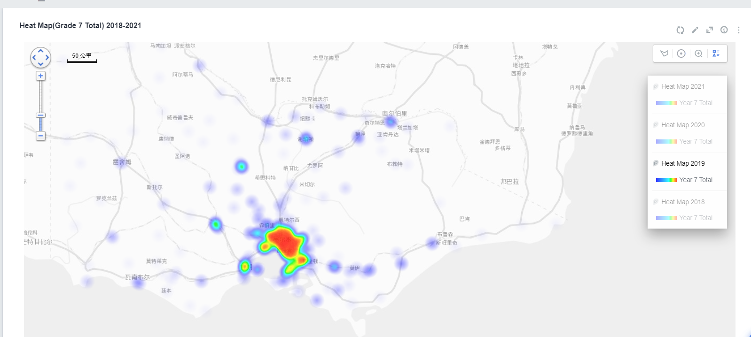
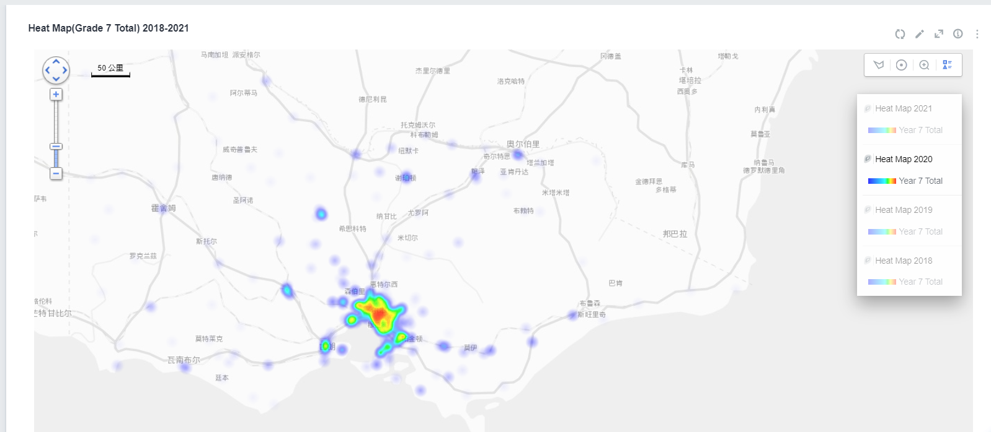
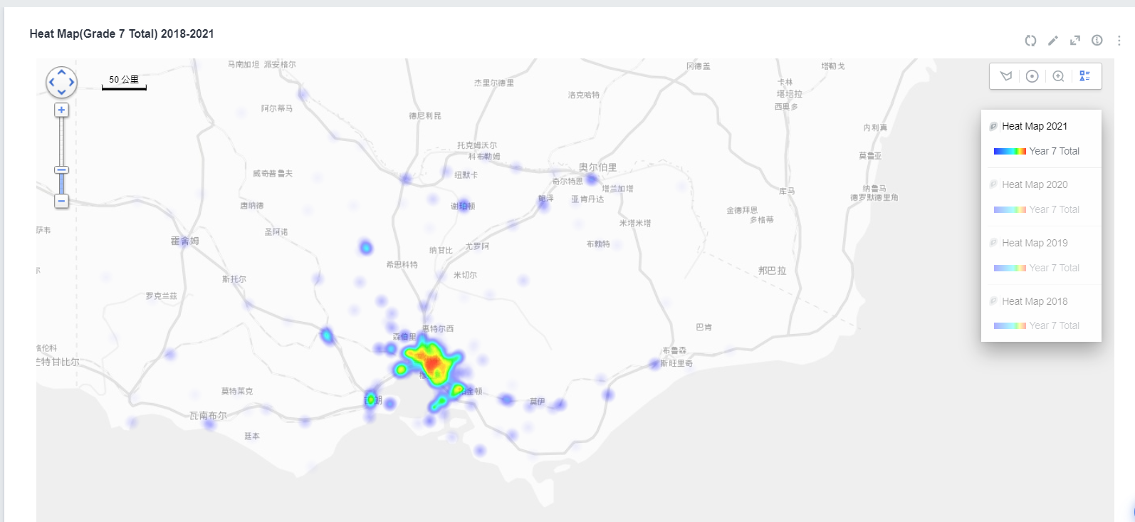
School Capacity-Predict the future trend
2018
2019
2020
2021

Slide 11
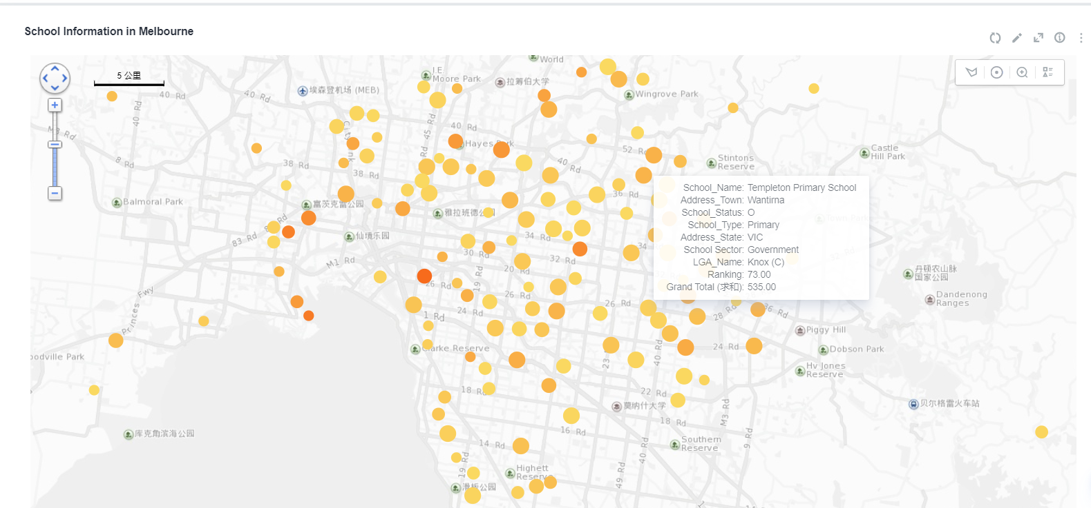
Detail information
km

Slide 12
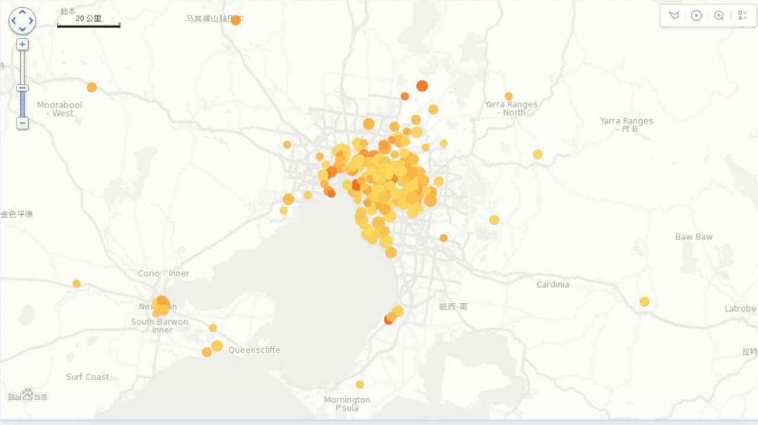

Slide 13
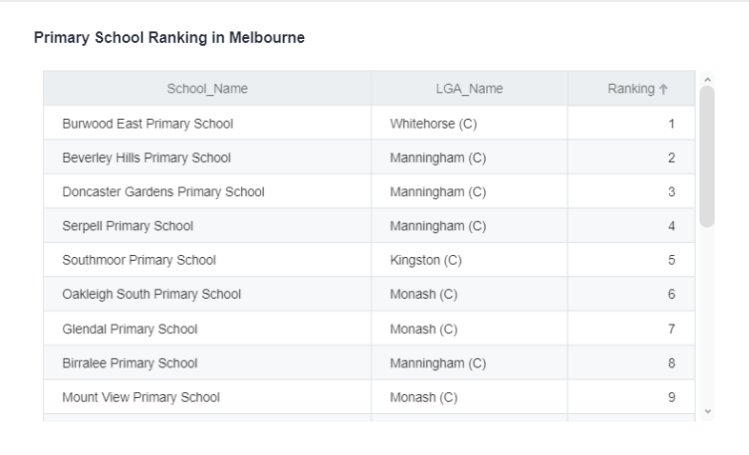
Ranking information

